Slide 1

IMAGE STEGANOGRAPHY
USING LEAST SIGNIFICANT BIT

Slide 2
AGENDA
Covert Communication
Security and Confidentiality
Resistance to Attacks
Versatility
Complementary Technique

Slide 3
PROBLEMS WITH SENDING PLAIN TEXT
Lack of Privacy
Security Risks
Message Tampering
Lack of Deniability
Regulatory Compliance
Steganalysis

Slide 4
PROJECT OVERVIEW
Get the input cover image and secret message.
Accept the stego-key from the user and calculate average value of them.
Convert each character of secret message and each LSB bit of cover image (R channel) from the position of average of stego-key.
Substitute the LSB bit of cover image (R channel) with binary values of secret message with respect to the starting point until the end of secret message.
Insert the end character value at the end of secret message.
Calculate the PSNR, SNR of original and resulting images.
Send a stego-image to the receiver.

Slide 5
PROJECT REQUIREMENTS
User Interface
Image Handling
Steganographic techniques
Encryption and Security
Compression and Error Handling
Performance and Efficiency
Documentation and Testing

Slide 6
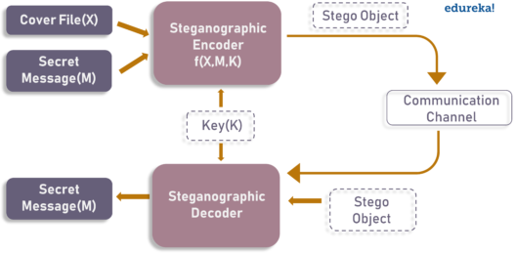
PROJECT ARCHITECTURE DIAGRAM

Slide 7
ANALYSIS
Fact finding techniques refer to the ways in which a software team discovers the various facts required for the development of the Steganography project. There are four techniques namely,
1. Questionnaire
2. Record Review
3. Customer Interviews
4. On-sight Observation

Slide 8
Planning:
Planning is very important in every aspect of development work. Software project plan indicated scope of the project, milestones and deliverables, project estimates, resource allocation, risk management, scheduling techniques and quality control and standard. Software project plan can be viewed as the following:

Slide 9
User Interfaces :
The use of Textbox and File and Folder browsing component for accepting input data. The input data are then used for processing the files.
Hardware Interfaces:
Large amount of binary data are processed in system; hence processor having free space will be useful for faster storage and retrieval of data. Here we have used 3.6 GHz P4 processor, which will have an additional support for our software.

Slide 10
WHO ARE THE END USERS
Individuals concerned about privacy
Journalists and whistle blowers
Intelligence and law enforcement agencies
Corporate professionals
Digital content creators and distributors

Slide 11
FUTURE ENHANCEMENT
Deep learning and neural networks: The application of deep learning and neural networks in image steganography holds promise for future enhancements.
Steganography in emerging technologies: advancements in virtual reality (VR), augmented reality (AR), or the Internet of Things (IoT) can create novel applications and challenges for steganography.
Security and encryption integration: Steganography can be combined with encryption techniques to provide enhanced security

Slide 12
CONCLUSION
We successfully embed data in an 8-bit color image. Additional features that could be added to this project include support for file types other than bitmap, and implementation of other steganographic methods.
However, this Project work and software package provide a good starting point for anyone interested in learning about steganography

